Slide 1

Password Visualisation
Dr Shujun Li (李树钧)
Deputy Director, Surrey Centre for Cyber Security (SCCS) Reader (Associate Professor), Department of Computer Science
http://www.hooklee.com/
@hooklee75

Slide 2
What is the research problem?

Slide 3
How much do we understand about how users choose their passwords?
Statistics e.g. top N mostly-used passwords from leakage password databases (with frequencies)
Use of common words in passwords (with frequencies)
Use of personal information in passwords
General rules to strengthen passwords (e.g. character replacement like ‘o’ ⇒ ‘0’, ‘l’ ⇒ ‘1’)
Tricks to produce complicated passwords e.g. password phrases
Reuse passwords cross different websites
Random passwords generated by password managers?
…

Slide 4



Our knowledge on real-world use of passwords ⇒ Password cracking
Dictionary attacks (+ permutations)
Personalised dictionaries
Statistical models e.g. Markov models
Linguistic models e.g. grammar-based models
Rule-based attacks
Partial brute force
Hybrid attacks
…

Slide 5
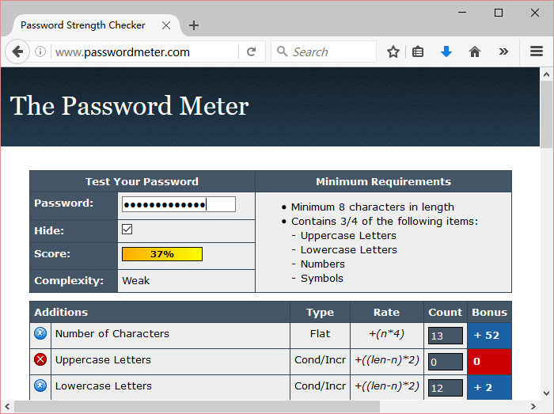
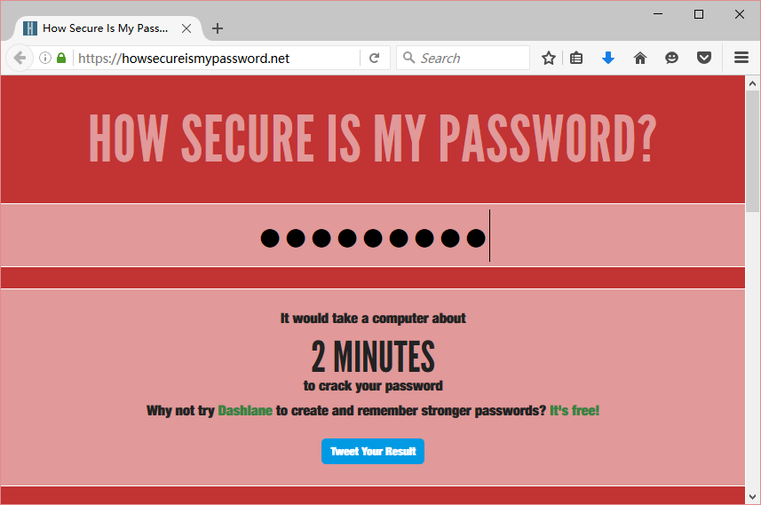
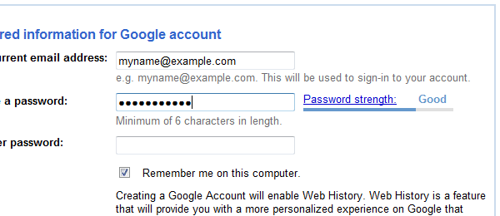
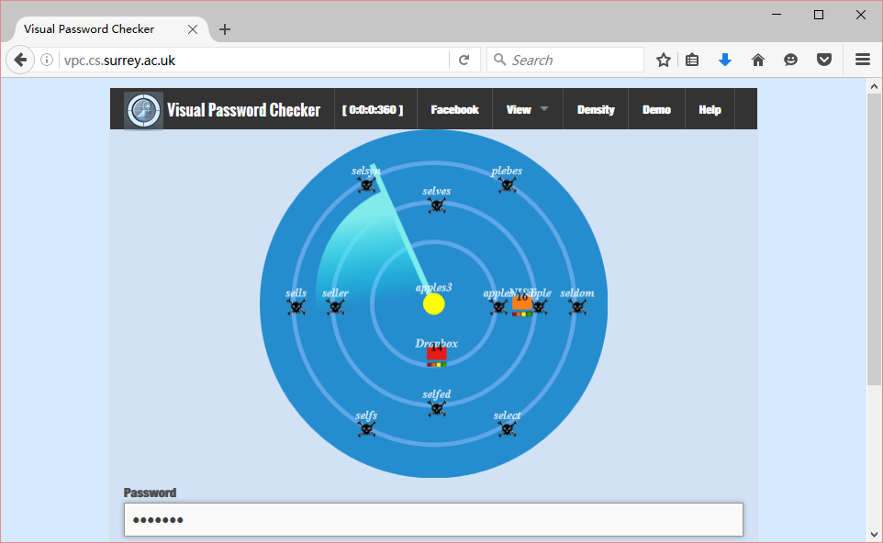
Risks to password crackers ⇒ Password strength meters/checkers
Password entropy
Password guess work
Dictionary-aware password meters/checkers
Fear appeal password meters/checkers
Peer pressure based password meters/checkers
…

Slide 6
Password strength meters ⇒ Password policies
The goal is to improve password strength of ALL users by enforcing some strict rules.
Are password policies effective in real world?
We hardly see any evidence and analysis.
So we don’t know how to improve!

Slide 7
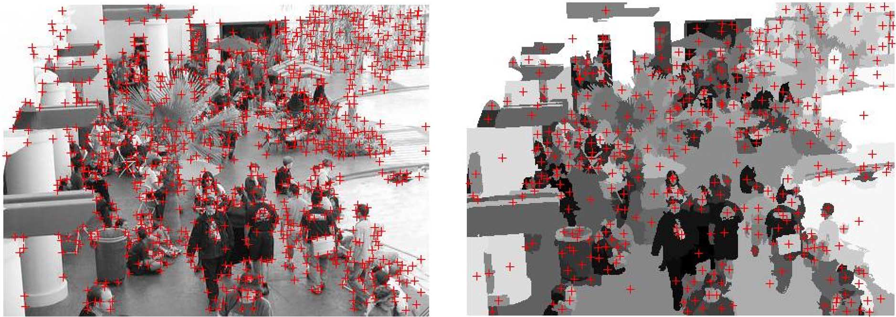
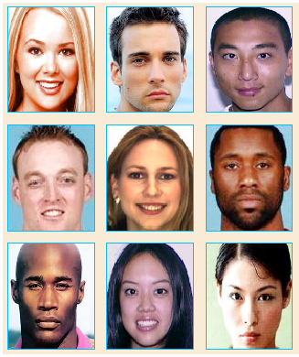
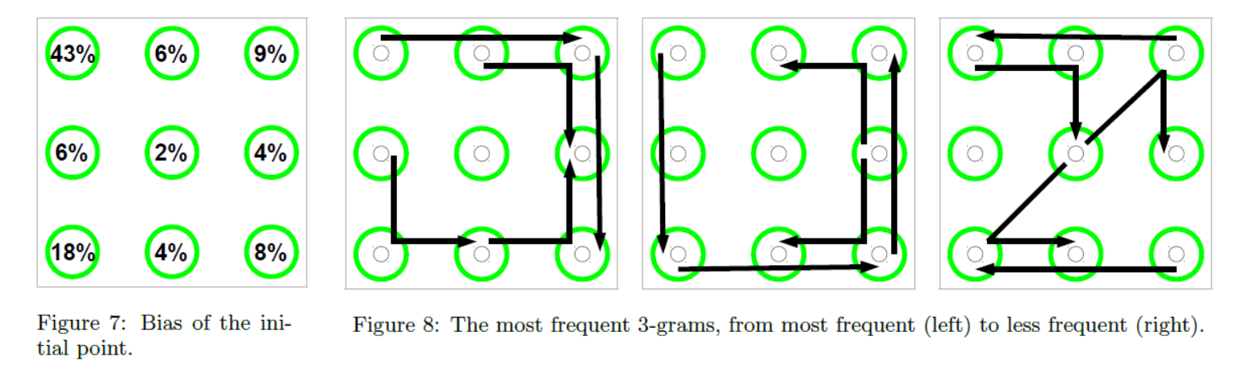
How much do we know about new forms of passwords?
Similar patterns observed for graphical passwords (e.g. selection bias in PassFaces, PassPoints and Android unlock patterns) ⇒ Dictionary attacks
Graphical password meters start emerging.
Graphical password policies are less studied!

Slide 8
Why does visualisation help?

Slide 9
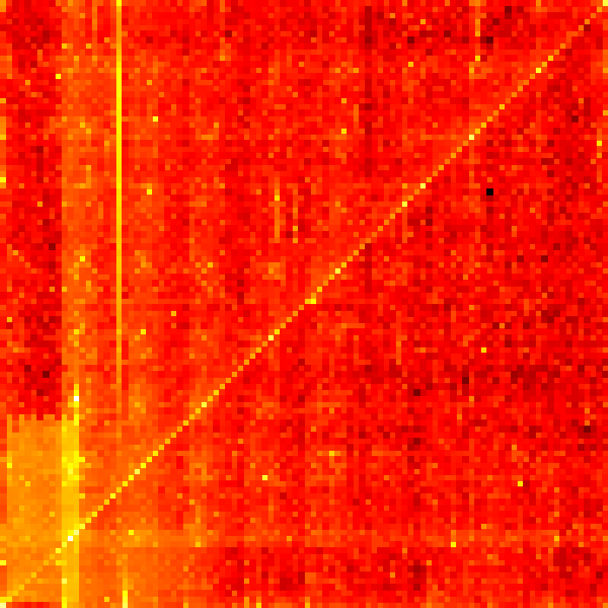
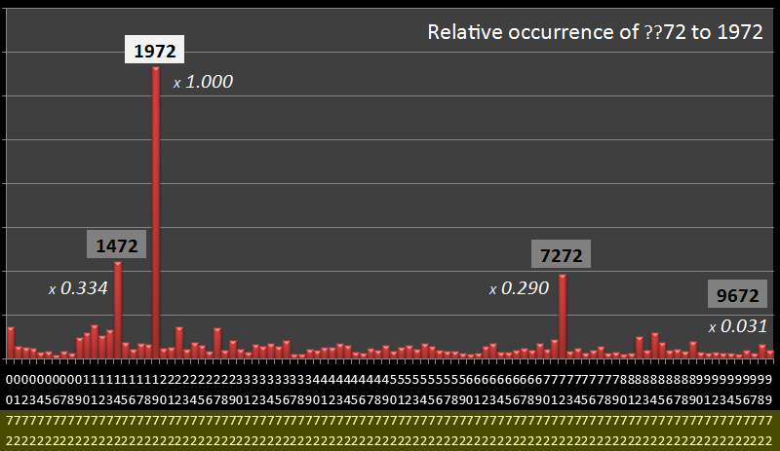
Visualisation reveals more patterns?
DataGenetics, PIN analysis, 3rd September 2012
3.4 million leaked passwords composed of 4 digits.
00xy
19xy
9999
xyxy
mmdd
xy00
Notes:
This is nice but hard to be generalised!

Slide 10
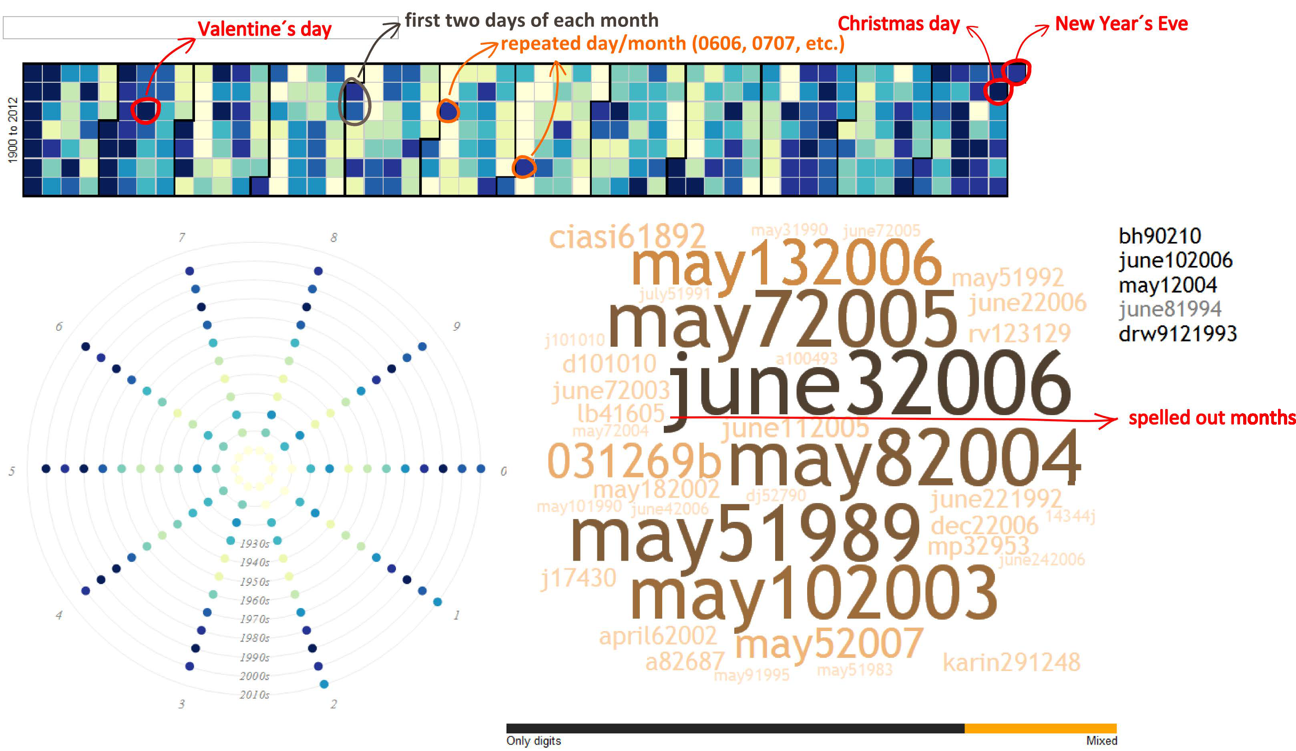
Visualisation reveals more patterns?
Rafael Veras, Julie Thorpe and Christopher Collins, Visualizing Semantics in Passwords: The Role of Dates, VizSec 2012
Notes:
Tile map + radial plot: frequent regions are evidenced by dark tiles.
Radial plot: All years of a certain decade are evenly distributed along a ring, in clockwise order. The rings, representing decades, are organized in ascending order from center to periphery.
Word cloud: The passwords are sized according to the number of times they occur in the underlying dataset.

Slide 11
Visualisation reveals more patterns?
Guo Xiujia, Chen Haibo, Liu Xuqin, Xu Xiangyu, Chen Zhong, The Scale-free Network of Passwords: Visualization and Estimation of Empirical Passwords, arXiv:1511.08324v1, 2015
Notes:
1) each unique password is a single node in the graph;
2) two nodes are linked if the distance between two corresponding passwords is less than D(i,j) (in this case, we assume it as 3);
3) repeat step 2 until every two passwords in the data set have been compared;
4) reorganize the graph and output the result.
12306’s top 100 passwords (link = ED<=3) => 12306’s all passwords

Slide 12
What ideas do we have?

Slide 13
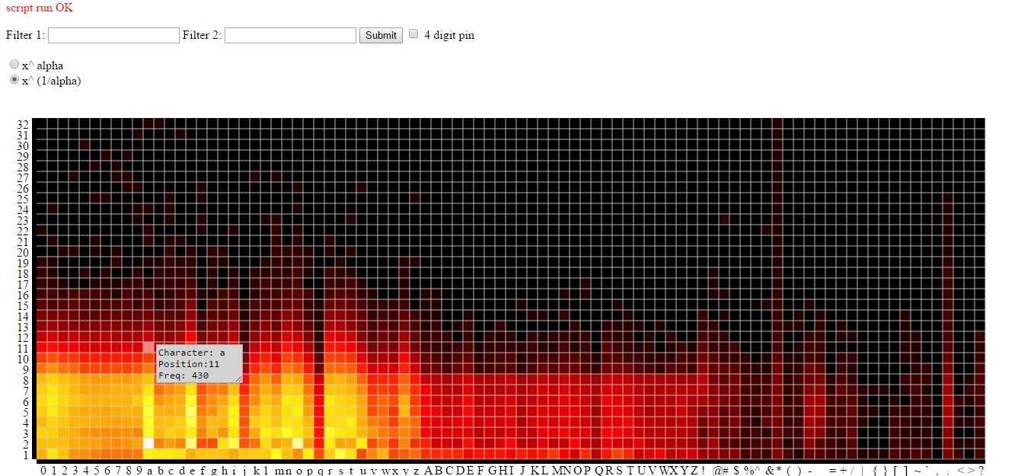
Idea 1: heat map + parallel coordinates
Generalised heat map: frequency of each character at each position
Parallel coordinates: each password is a segmented line on the heat map
Many ways to customise the visualisation (via HCI)…

Slide 14
Idea 2: better password clustering
Identification of key password segments
Via pre-scanning of the whole password database
Visualisation of selective password segments to handle scalability
Use any dimensionality reduction methods for visualisation
Password segments as anchor points to accommodate individual passwords
A password can be attached to more anchor points if needed

Slide 15
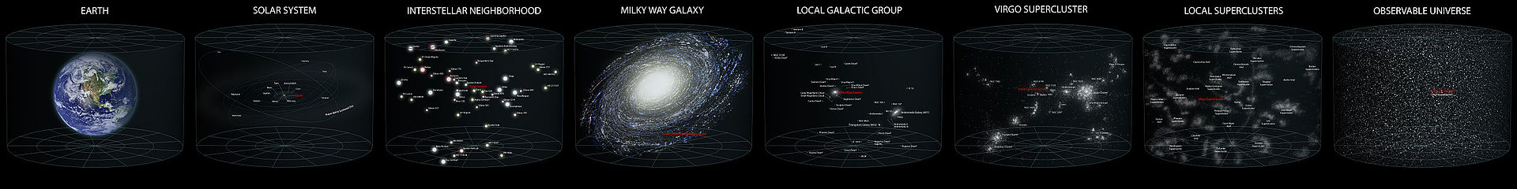
Idea 3: passwords in a universe
A password database is a universe. (⇒ Parallel universes)
A (possible) password is a star in a universe.
Brightness/Size of a star = A password’s popularity
Distance between two stars = Similarity of two passwords
Between stars and the universe: Star systems ⇒ Galaxies ⇒ Galaxy clusters ⇒ Superclusters
The whole universe is viewed from a single star, the Earth.
The viewer can move from one star to another.
Loneliness of a star = A password’s strength
Fractal dimensionality of the universe = The overall strength of the whole password database

Slide 16
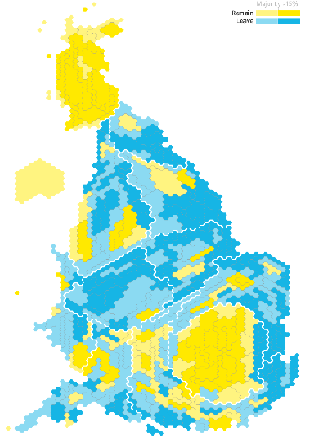
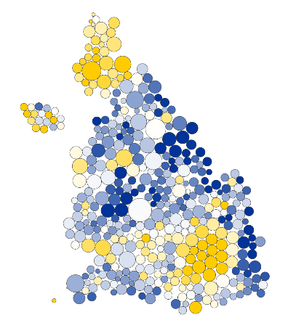
Idea 4: special types of passwords
Passwords related to geo-locations
This can be visualised on a map.
There are many words linked to geo-locations e.g. countries, cities, rivers, lakes, mountains, languages, people, wars, religions, …
Passwords related to person names
Passwords related to animals and plants
…
Specialised visualisation methods will be needed.

Slide 17
Idea 5: mixing everything together
All the above ideas can be merged into a single system.
An interactive HCI allows users to switch from one view to another, to compare two or more in the same view, and to add different layers showing different things (e.g. dictionaries vs. password databases, English vs. German).
This can also include traditional password analysis tools which normally produce numerical results (largely different kinds of statistics).

Slide 18
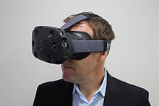
Idea 6: 3D world + virtual reality
All the previous ideas can be generalised to 3D worlds.
An interesting approach to exploring the 3D visualisation world is to use VR.
For the heat map idea, one can be surrounded by multiple heat-maps in a 3D world.
For the password clustering idea, one can see, touch and stretch all passwords and clusters in 3D world.
For the password universe idea, one can see the password universe like using a telescope to view our physical universe.

Slide 19
Idea 7: non-textual passwords?
This is a whole new world nobody has done anything on password visualisation!
Interesting graphical/hybrid passwords
Android unlock patterns
Microsoft Windows picture passwords
PassFaces
PassPoints
Pass-regions (a new concept I developed)
Password+ (a very new concept I am developing)

Slide 20
Idea 8: passwords of a single user
A special subset of all passwords is a single user’s passwords.
This includes two types:
All passwords the user is currently using across all accounts (horizontal)
All passwords the user has been using for a period of time for a single account (vertical)
Different visualisation strategies are needed for the two types of personal passwords.
They can be combined to show everything all together.
This may be better done in a 3D space with a time axis.
Can be made local (only seen by the password owner) so access to clear passwords is not an issue.

Slide 21
Can we use passwords collected by legitimate parties from end users?
We need to anonymise and unlink passwords from user identities.
This can cause loss of semantic meanings.
Global topological features may still remain.
Matching new passwords to old ones can be impossible.
The solution?
Distance-preserving hashing
Pre-computed hashes of anchor passwords
Reactive password checkers have been used to get passwords in clear so this may give a significant portion of passwords for visualisation.

Slide 22
As tools to design new password crackers and meters/checker
Identify unknown patterns
Study complicated patterns
Compare different password databases
…
⇒ Defining better rules and attack strategies

Slide 23
As tools for cyber security awareness, education and training
Understand known patterns better
Discover unknown patterns more easily
Learn with fun
Interaction allows user customisation
...
Can introduce gamification to encourage users to explore the password space more in-depth

Slide 24
As tools for password owners (users)
If the visualisation can be done in (near) real-time, any password visualisation method can be part of a visual password checker to assist users for defining passwords.
For the heat map idea, the current password will be a segmented line on the heat map and a numeric value can be calculated to show the relative strength of the password.
For the password cluster and password universe ideas, the current password will be a new point/star whose loneliness can be used to represent its strength.
Visualisation of personal passwords can help users define better ways to choose their passwords.

Slide 25
As tools for password policy makers
Password policies = A set of permissible passwords
⇒ This can be visualised as well!
Password policy vs. Actual passwords defined by users under the policy Password policy vs. Password policy
Hypothesis: most passwords are just above the lower surface of the permissible space.
Goal: how to define the password policy to enforce/encourage users to go (more) beyond the lower surface

Slide 26
As tools for art/fun
The visualisation results can be aesthetically beautiful.
⇒ Why can’t they be produced simply for fun?
I am really eager to see the password universe graphs and want to mount some on my office’s wall!

Slide 27
The Team

Slide 28
The password visualisation team
UK
Shujun Li (lead): Professor of Cyber Security at the University of Kent
Georgi Damyanov, Andrew Periam, Vuk Strajnic: UG students at the University of Kent (2018-19)
Gary Read: MSc student at the University of Surrey (2015-16)
Leishi Zhang: Senior Lecturer at the Middlesex University
Germany (University of Konstanz)
Stefanie Schmid: visiting student at University of Surrey (06-09/2017)
Michael Blumenschein: PhD student/RA
Daniel Keim: Professor (Data Analysis and Visualization)
Saudi Arabia
Nouf Aljaffan: Assistant Professor at the King Saud University
Hong Kong (City University of Hong Kong)
Yin To LEE: visiting student at the University of Surrey (05-08/2015)

Slide 29
Thanks for your attention!

